Slide 1


BSC-CC247 Overview and Supporting Plan

Slide 2
AGENDA
01
BSC-Overview
02
CC247 Overview
03
Supporting Plan

Slide 3
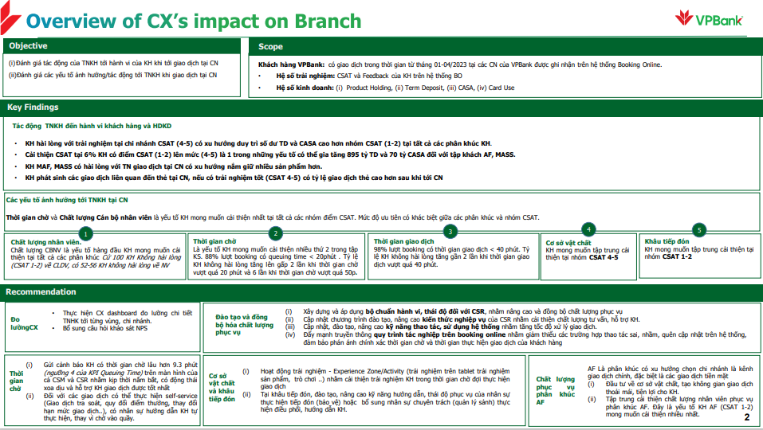
Branch Service- Overview
2 FTE support BI Report and Payment requests:
Analysis
7 analysis about branch service:
3 analysis to increase Customer Experience in branch services
1 analysis about customer’s behavior who had transaction in Kiosk Bank.
3 other analysis about sale (review FX Sale contest, review “CIF handles by BSC”) and transaction in counter (SME Customer Deposit transaction)
24 Total Regular Report ~80% is complex and medium Reports which includes a lot of indexes like:
Sale tool, CSR Tool (cover about 28 indexes)
KPI (cover more than 130 non-sale transaction types and more than 10 KPI index …)
…
18.5 bil VND Total Branch service payment in 8 months of 2023.
Increase ~20% compare to last year.
Includes:
17.6 bil VND Incentive
0.9 bil VND commission (From Jan to Jul 2023)
5 sale-contest (each sale-contest run about 6-12 months)
Data:
Support to review and clear requirement to ETL data from booking online system to DWH then support report and analysis

Slide 4
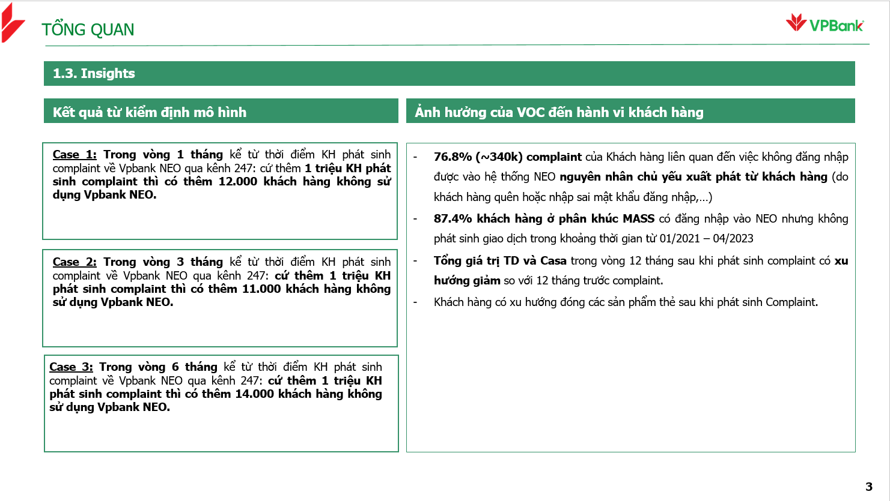
CC247- Overview
1 FTE support all BI Report and Payment requests:
Analysis
94 Total Regular Report ~56% is complex and Medium Reports which includes a lot of indexes like:
CISCO dashboard (include FCR, Abandon rate, Callback… for all segment, all channel (call, mail, fb, zalo…)
247 dashboard
KPI Agent
Sale-tool
…
3 analysis about Customer complaint on 247 Channel about:
Customer behavior after complaint on 247 channel about not sign in on NEO app
Customer behavior after complaint on 247 channel about not trusted devices
CX’s impact on using NEO
1.6 bil VND Total CC247 payment in 8 months of 2023.
Increase ~10% compare to last year.
Includes 2 teams:
1.55 bil VND incentive for team Sale
50 mil VND incentive for team Pre-Retention (from Jun.2023)
4 Sale-contest (each sale-contest run about 6-12 months)

Slide 5
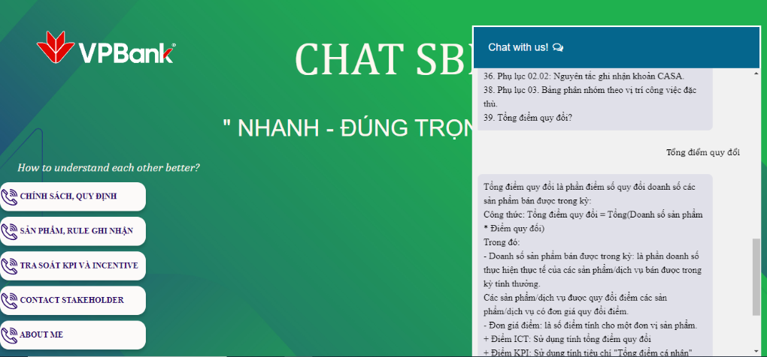
Support Plan Branch Service and CC247 for new demands on Q4.2023
CC247
BSC
Analysis:
Support 2 analysis about customer experience on 247 Channel
Support 1 analysis about customer persona who are VKYC on CC247 to increase credit card refer rate
Analysis:
Support 1 analysis about customer experience on branch service and CX’s impact on branch.
BI Report:
Build new dashboard about Booking online system (This data was go-live from Sep.2023)
Build new reports about private banking
Build new productivity model reports based on new calculation
Build new report about business discipline, promotion staff, …
Payment:
Support to calculate new sale contest for team Pre-retention
BI Report:
Build 5 new reports about: lead convert from crm cru, pre-approved miss call, closed card lead, …..
Initiative:
Plan to develop a chat-bot to quickly support client as below:
Data:
Plan to build 247 data-mart to fully and quickly support each request of 247
Support to review BRD, clear requirement to ETL data from callbot, Chatbot and Voice-biometric on Cloud as details:
414 data term Call bot and Chatbot
57 data term Voice Biometric
Build Data product (Callbot, chatbot and Voice Biometric) on Cloud
Support 20 new reports about call bot, chat bot and Voice Biometric

Slide 6
Xây báo cáo theo dõi năng suất lao động non sale hằng tuần
Các báo cáo chuyên đề kiểm soát rủi ro vận hành (Giao dịch mở/tất toán STK/TKTG thực hiện sau giờ làm việc, Vay cầm cố đảm bảo 100% TK tiền gửi là GTCG, Thấu chi, Bảo mật user)
Nghiên cứu bắt volume tự động cho dữ liệu KPI tính tay
Xây báo cáo dashboard Booking online (đơn vị yêu cầu bổ sung các trường thông tin liên quan đến SKIP TIME, dự kiến golive dữ liệu trong tháng 1)

